Slide 1
New York City Taxi Fare Prediction
Group 8: Ben Sullivan, Shubham Singh, Ally McNulty, Rhiannon Pytlak

Slide 2
About the Data Set
New York City Taxi Fare data provided by Kaggle
1,000 observations with 7 columns
This data set includes the following variables:
fare_amount
passenger_count
Location-based:
pickup_longitude
pickup_latitude
dropoff_longitude
dropoff_latitude
Time-based:
Pickup_datetime
Our objective is to figure out what combination of variables can best predict the fare amount that will be charged for any given taxi ride in New York City.
Notes:
Ben

Slide 3
Raw Data Analysis
Notes:
Ben

Slide 4
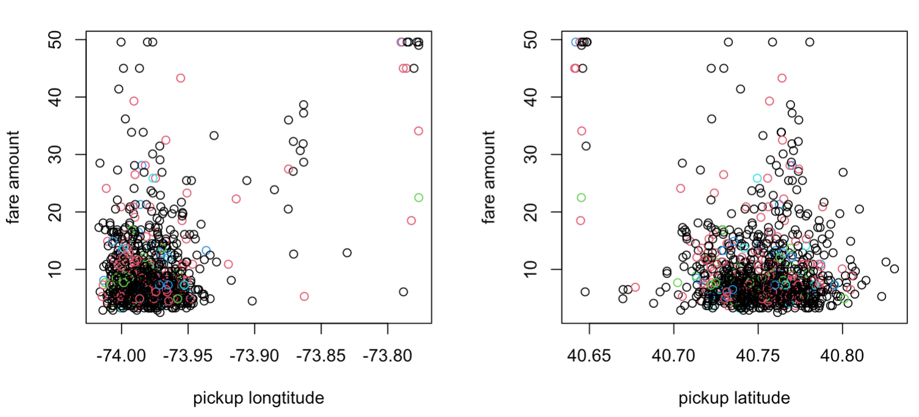
Location-Based Predictors
Notes:
Ben
No clear relationship observed. Raw lat-long data of pick up and drop off may not help us in predicting the fare amount.
Variation of location based predictors is low, we thought of combining location variables to create new features
This will help us introduce non-linearity in our model

Slide 5
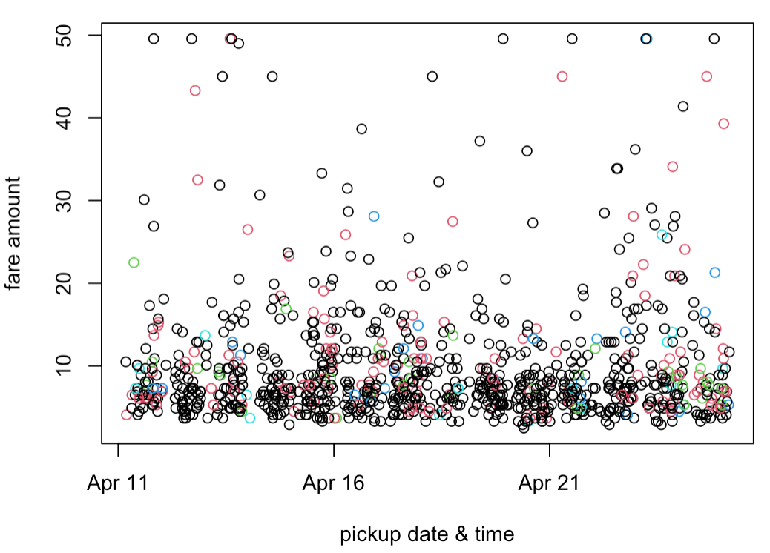
Time-Based Predictors
Notes:
Ben
Fare amount is clustered in a window range between 0 and 15 values across all the days
We can’t decide about a parametric trend that the time-based variable has with the predictor variable.
However, the presence of non linear trend is observed in Time based features, thus we decided to consider the use of non-linear models

Slide 6
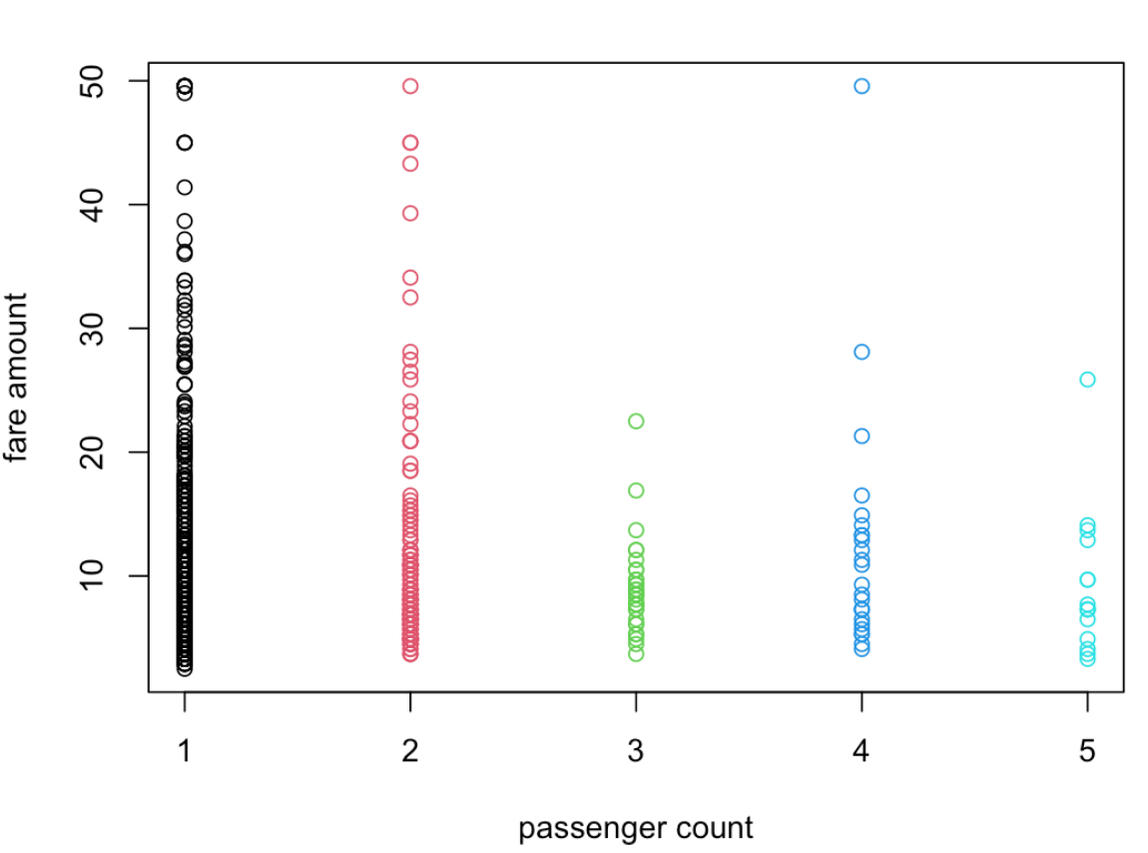
Passenger Count-Based Predictors
Notes:
Ben
It seems that taxis with high passenger count have low fare amounts (negative correlation if we only focus on median fare amount for each level of passenger count), however NO appreciable relationship(linear) can be estimated for this hypothesis

Slide 7
Baseline Modeling
Notes:
Now that we have analyzed the three types of data available, we decided to build a baseline model in order to gain an understanding about how our variables behave

Slide 8
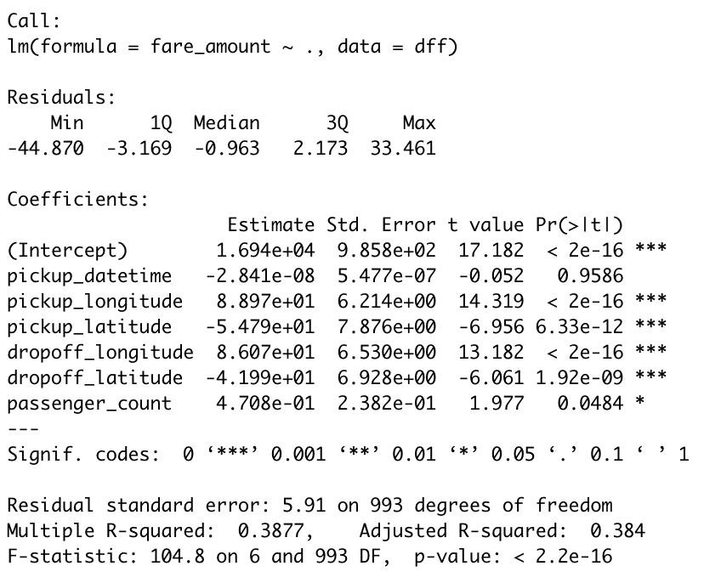
Baseline Linear Model Results
Notes:
Shubham
As we already have location, time and count based variables we decided to train a MLR model to evaluate performances of each predictor
(we were sceptical of using linear parametric model but for baseline estimation purposes , we decided to move forward with it)
The first observation to make is that the regression coefficients for location-based predictors are high, while their p-values are significantly low.
Therefore, this model suggests that there is appreciable degree of relationship between location-based predictors and fare amount
However, this model was only able to explain 0.38 proportion of variance (adjusted R^2) → 38%
Additionally, the error of model is quite high (5.91), considering the mean value of the fare_amount variable is $9.8.

Slide 9
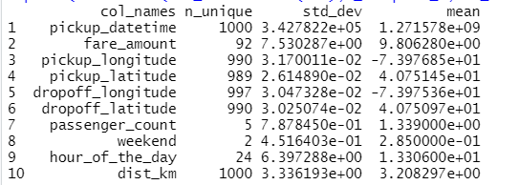
Features Added
1) Distance between pickup and dropoff location (dist_km)
2) What hour of the day each ride is taken (hour_of_the_day)
3) Weekend binary variable (weekend) where:
1 = the ride during a weekend
0 = the ride was during a weekday
Notes:
Shubham
Based upon the results of our regression, we see that we have date/time and location centric data, so we wanted to see if creating new variables would improve the accuracy of our preliminary model
The features we added are as follows
1) Distance between pickup and dropoff location
This was computed using Haversine formula (R package available)
2) What hour of the day each ride is taken
Extracted from datetime
3) Weekend binary variable where 1 = the ride during a weekend, and 0 = the ride was during a weekday
Also extracted from datetime
This predictor creation also helps us find the non-linear trend of our data, as we are moving from linear to non-linear parameters (combination of predictors)

Slide 10
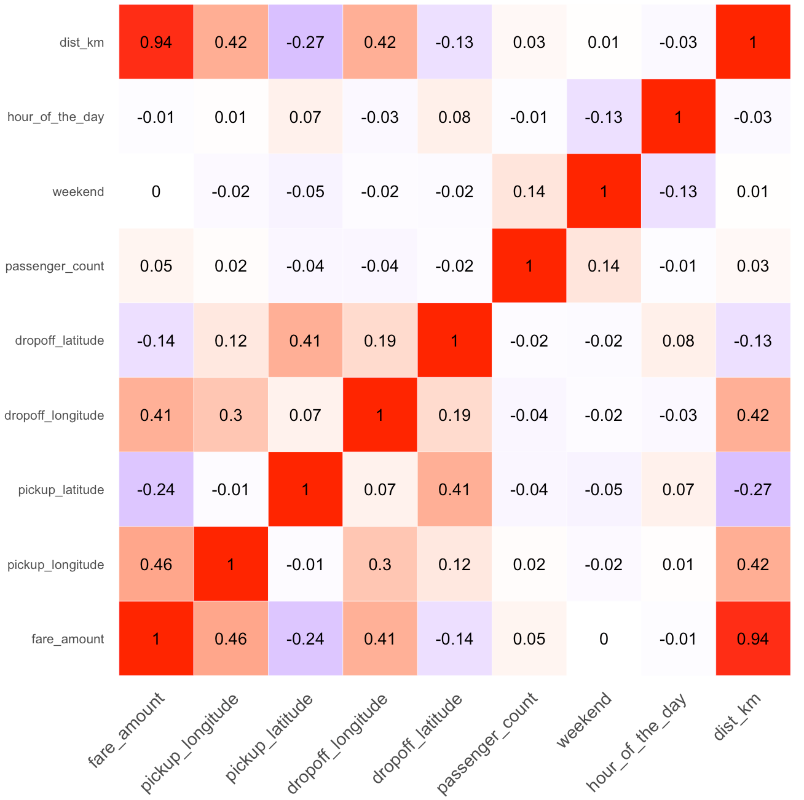
Features Added- Observations
Newly created dist_km variable demonstrated a positive, high degree of correlation with fare_amount
Notes:
Shubham
We wanted to look at the correlation strength of the new variables to see if they help improve the interpretability of our model
This correlation matrix suggests that the newly created dist_km variable has demonstrated a positive, high-degree of correlation with fare_amount

Slide 11
Linear Models
Notes:
Now that we have included the new variables in the data set, we want to try fitting baseline linear models to see if the variable inclusion helped the accuracy of or model

Slide 12
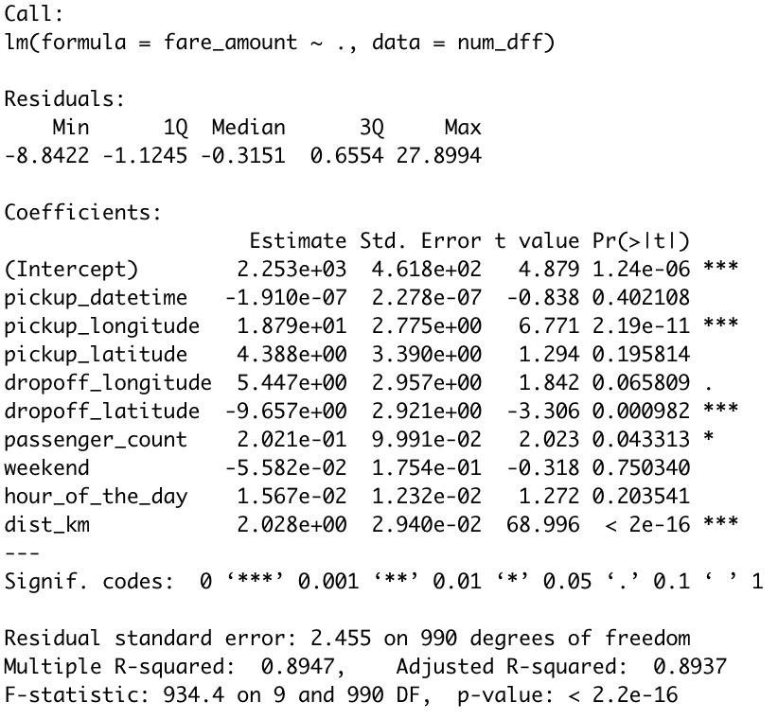
Multiple Linear Regression
Distance seems to be the primary determinant of fare_amount for this dataset
Lat & Long variables were showing high correlation with fare _amount, but were not able to predict it well.
Our new variable does that.
Fare amount does not depend much on time-based features, or at least does not have linear trend with time-based variables.
Notes:
Ally
Next, we tried using multiple linear regression with the new variables!
Recall that our original adjusted r-squared in the first multiple linear regression was 0.39
In this MLR model with new variables, our adjusted r-squared is 0.89, indicating that the model explains a large portion of the variance in the response variable (fare_amount).
This large jump in R-squared happened solely because we created the dist_km variable and two time-based variables (weekend & hour_of_the_day). In addition, the residual standard error went from 5.91 to 2.455 due to this variable creation.
However, when looking at the newly created “hour_of_the_day” variable and weekend variable, we notice that their p-values are higher than 0.05. This leads us to assume it is likely to observe a substantial association between each predictor and the response DUE to chance, making these variable predictions unreliable.
Our final observations for this model include:
1) Distance seems to be the prime determinant of fare amount for this dataset
2) While location-based features were showing high correlation with fare amount, but were not able to predict it well. Our new variable does that.
3) Finally, Fare amount does not depend much on time-based features, or at least does not have linear trend with time-based variables

Slide 13
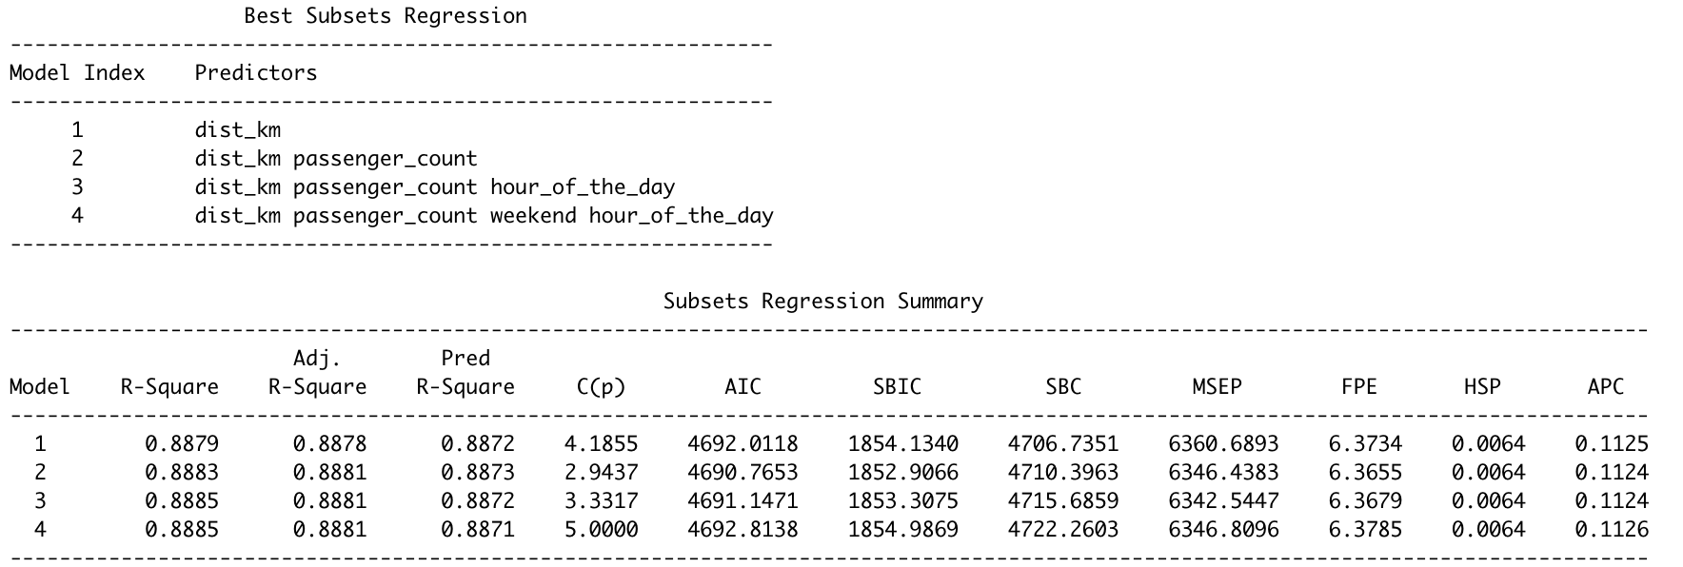
OLS Best Subsets Regression
Notes:
Ally
After determining the importance of each variable in the multiple linear regression, we wanted to see what combination of variables were the most predictive of fare_amount. To do that, we ran an ordinary least squares best subsets regression.
As you can see, adjusted r-squared for models 2, 3, and 4 is exactly the same. However, we care more about the predictive power of this equation, so we look to pred R-square to find that model 1 and 3 have almost the same predictive power!
Now knowing this from our original data, we set out to see if we can confirm these findings with repeated out of sample testing.
Test set =200 samples
Train set =800 samples
DF original_datset
Test set error mse= 30
DF new
Test set error mse=8

Slide 14
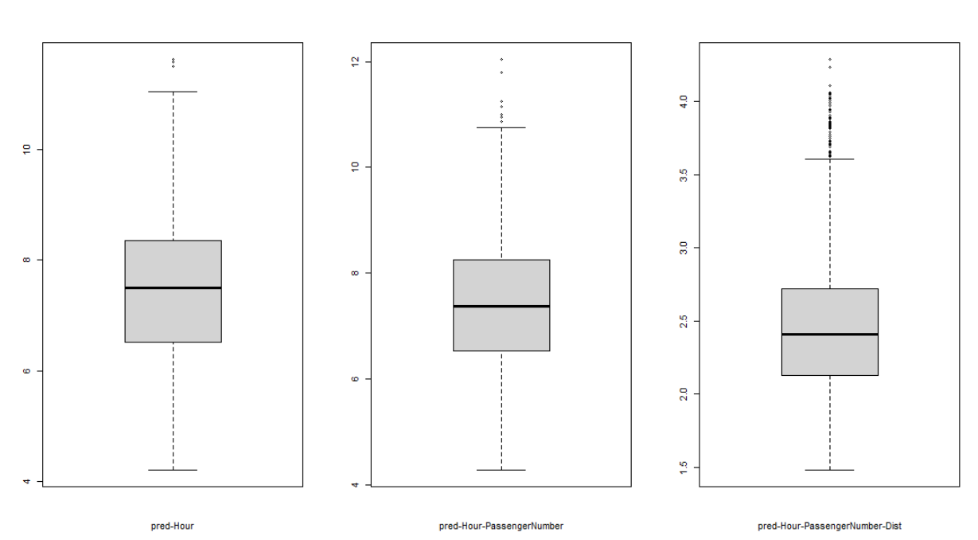
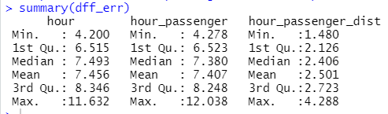
Repeated Out-of-Sample Experiment
Notes:
Ally
In this experiment, we selected (1) dist_km, (2) passenger_count, and (3) hour_of_the_day as our top 3 predictors (model 3 from previous slide).
We hypothesized three models:
Model with only hour_of_the_day as a predictor
Model with hour_of_the_day and passenger_count and
Model with all three predictors (adding in dist_km last)
We wanted to confirm the priority order, so we devised an experiment where we estimated the 1000 hold out test set errors (RMSE) by training our linear regression model first only with hour_of_the_dasy, then hour_of_the_day+passenger_count and finally with all the three variables (hour_of_the_day+passenger_count+dist_km)
We found that addition of dist_km reduces the test error to a significant extent! In fact, this RMSE is even smaller than the RSE that came from multiple linear regression

Slide 15
Non-Linear Models
Notes:
Rhiannon:
Exploratory analysis and linear regression modeling determined that predictors related to time of a taxi ride had a negligible relationship to fare_amount.
The distance variable’s strong relationship with fare_amount and other potential factors led us to the implementation of non-linear models.
The objective of these non-linear models is to create a regression model with even less error, using predictors such as distance that showed promising results.

Slide 16
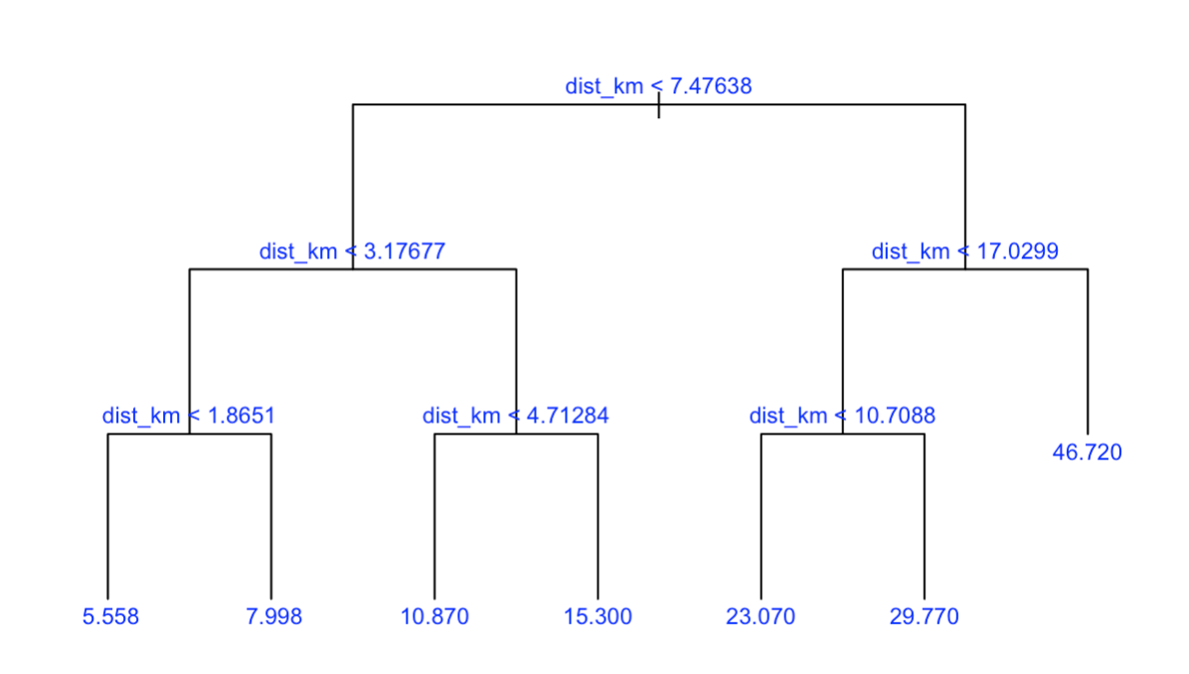
Simple Tree Model
RMSE: 7.08
Notes:
Rhiannon:
The first non-linear model we will look at is the simple-tree model.
To create our simple tree model, we split the data set in half and allocated each half to a training set and a test set. Simple tree models are known for increasing the interpretability for a model, so we hoped to gain further insights.
Despite utilizing all variables in the creation of this model, the dist_km variable alone created 6 different internal nodes/leaves that helped categorize fare_amount.
The RMSE obtained after cross-validation is 7.08, which is the highest/worst we’ve seen so far. This proves that a simple tree model is not the best model for our data.

Slide 17
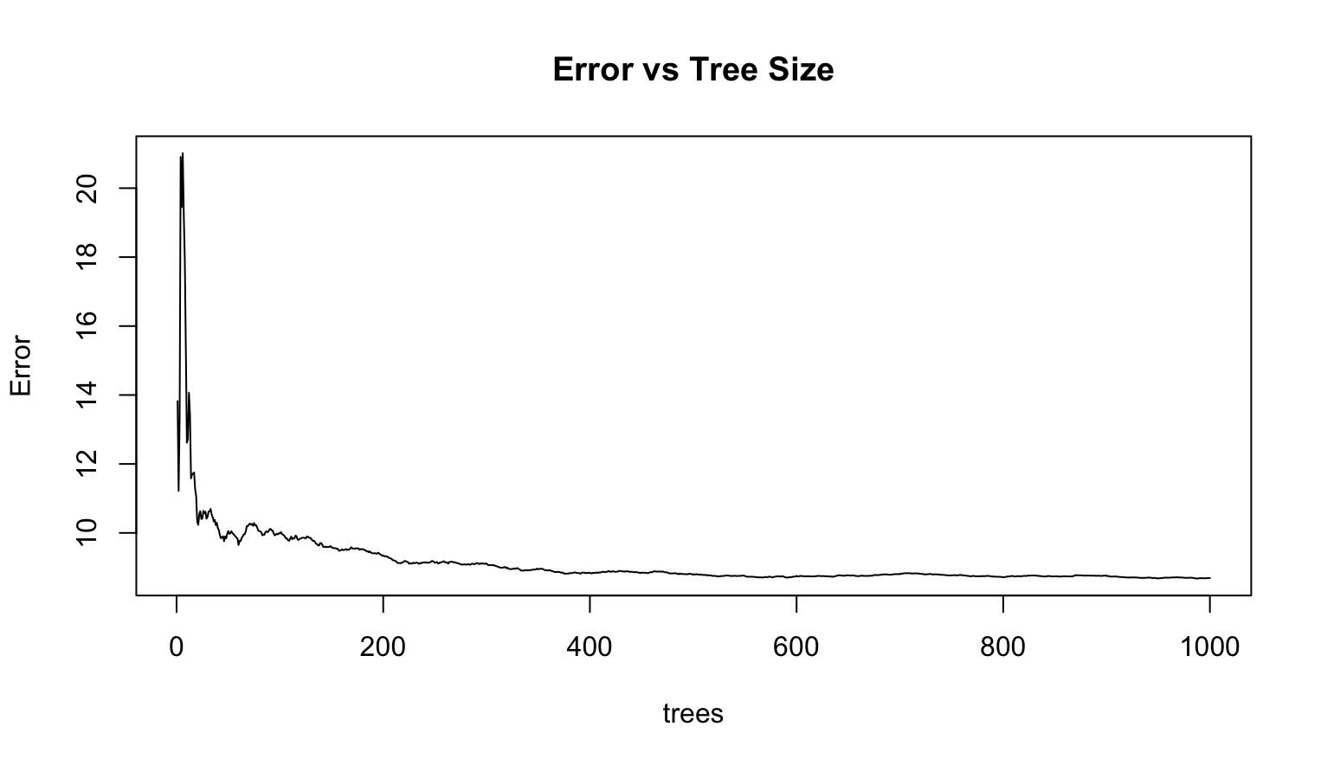
Random Forest
In and Out-of-Sample Loss on Validation
mtry ntree olrf ilrf
1 9 100 2.531 2.770
2 3 100 2.584 3.005
3 9 500 2.426 2.763
4 3 500 2.589 2.946
5 9 1000 2.488 2.773
6 3 1000 2.601 2.948
Notes:
The next non-linear model we will look into is the random forest in an effort to reduce RMSE from our previous examples
We ran a random forest model using 100, 500, and 1000 trees. An m value of either 3 or 9 was used as the number of random sample candidates to be considered as predictors candidates at each split.
Model showed that the out-of-sample loss on validation was better with m=9 for all three tree sizes and the model with m=9 and 500 trees produced the smallest out of sample error of 2.763
This is a substantially better out-of-sample error compared to what the simple tree model showed us.
However, it is telling us that 9 variables were randomly sampled as candidates at each split.
In regards to interpretability, that makes things more difficult! Especially since our easy-to-interpret multiple linear regression model produced RMSE that’s smaller.

Slide 18
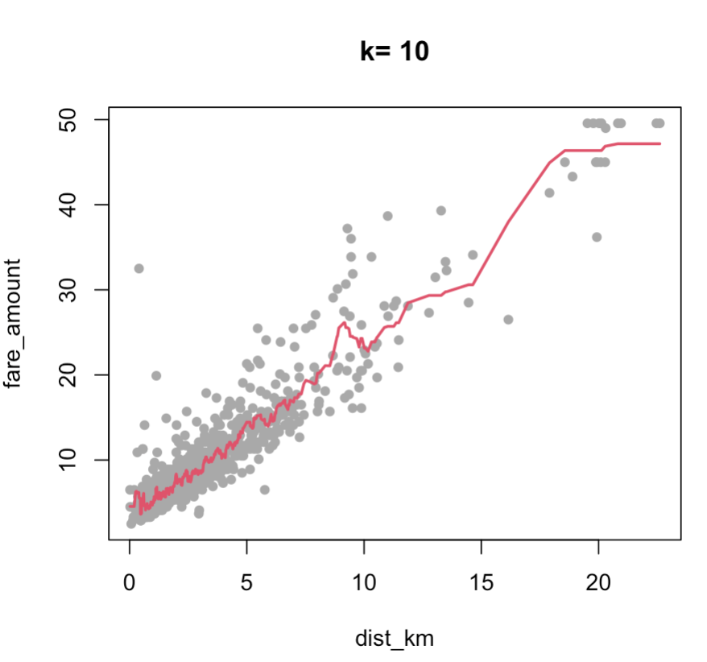
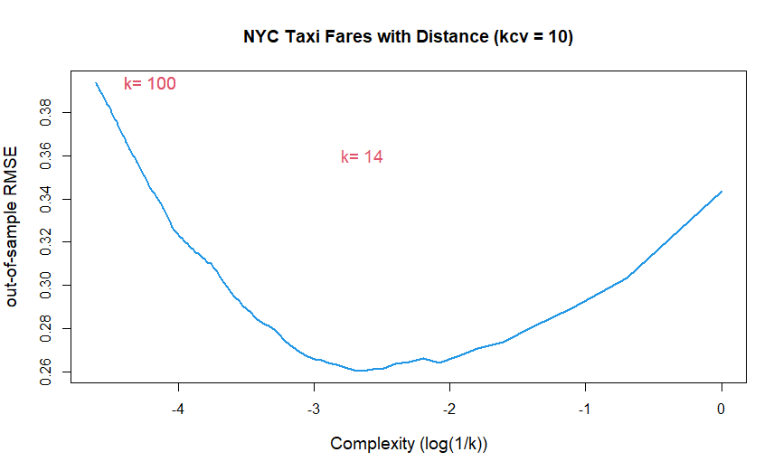
K-Nearest Neighbors
RMSE = 2.616
Notes:
Rhiannon
The next model we looked at is the k-nearest neighbors regression.
KNN works by finding the distances between a query and all the examples in the data, selecting the specified number examples (K) closest to the query, then votes for the most frequent label (in the case of classification) or averages the labels (in the case of regression).
Looking at JUST distance in relation to fare amount, we get a k value of 10 and a RMSE of around 0.2616. That is already substantially lower than the last RMSE from our repeated out of sample trials! This leads us to realize the importance of just distance in predicting fare amount.
But what about passenger count that was mentioned earlier by our best subset linear model? Would that help us in our cross-validation?

Slide 19
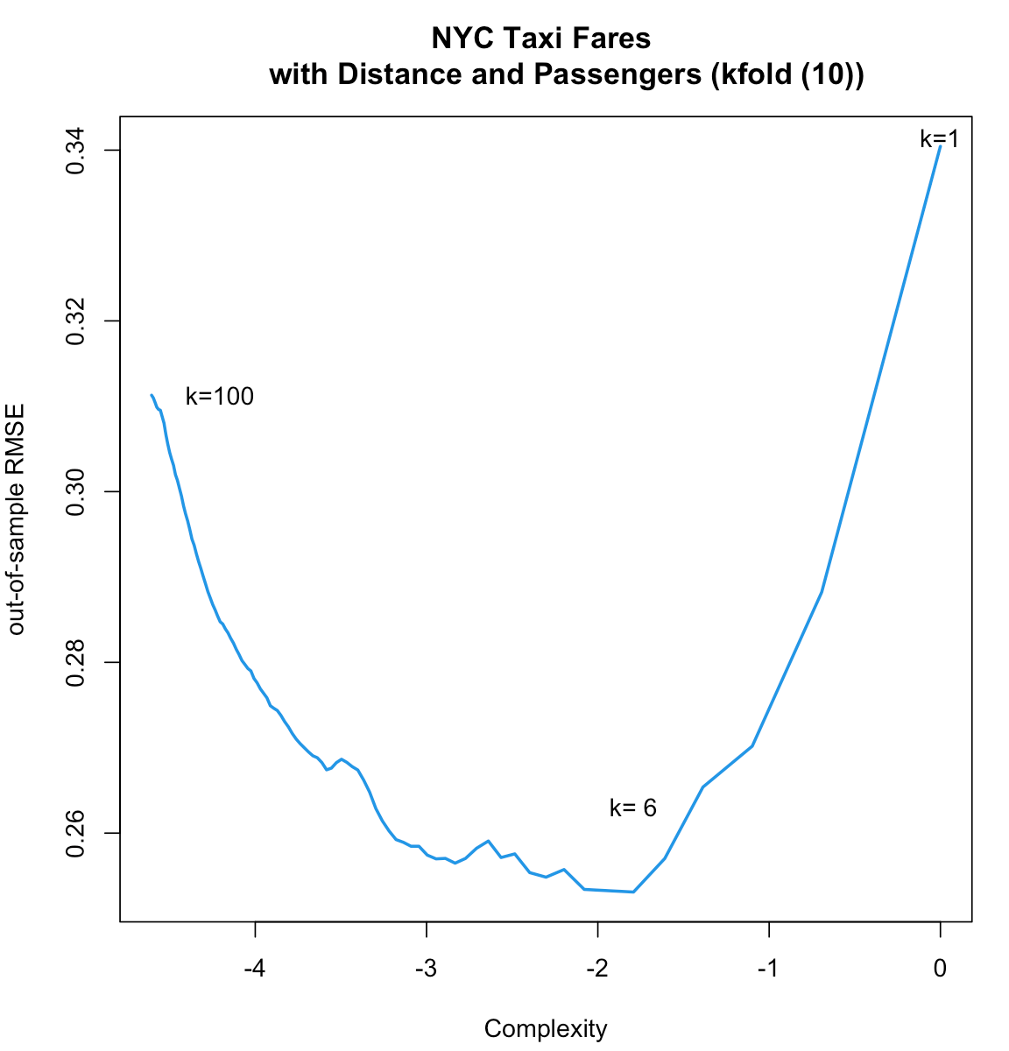
KNN Improved Model
RMSE = 2.482
Including passenger_count variable leads to error improvement when used with dist_km variable
Lowest RMSE = 2.482
Notes:
Rhiannon
When we included passenger_count with distance as predictor variables for out-of-sample testing, we got an out-of-sample RMSE around 2.48, which is very close to the RMSE output by MLR!

Slide 20
Summary & Conclusions
Notes:
Ben
“We have explored quite a few models for our New York Taxi Fare data set, and we have summarized our model comparisons in the following table”

Slide 21
Matrix for Model Comparison
Model | RSE/RMSE
Simple Tree | 7.08
Baseline Model (MLR) | 5.48
K-Nearest Neighbors | 2.48
Updated Baseline (MLR) | 2.46
Random Forest | 2.43
Repeated Out of Sample (Test set) | 2.41 RMSE
Notes:
With the analysis we’ve done so far, we believe the model with the best fit for our data seems to be the Multiple Linear Regression model. This is derived from the fact that our out-of-sample test set for our MLR model returned a 2.41 RMSE.
However, we saw that the K-NN and random-forest models also yielded comparable RMSE’s

Slide 22
Summary of Findings
Dist_km variable= MOST important factor in determining fare_amount
Best combination of predictors obtained = dist_km, passenger_count, & hour_of_the_day (in priority order)
Repeated out-of-sample experiment verified priority order of the three predictors
Non-linear models, along with our linear models, suggested that the fare amount primarily depended on location-based parameters
Dist_km variable along with passenger_count helps us predict fare amount to a good extent
Notes:
Ben
Therefore, we can summarize our findings as follows:
The dist-km variable obtained from the location-based variables turned out to be the MOST important factor in determining the Fare Amount
The ordinary least squares regression helped us obtain the best combination of three predictors that were ‘dist_km’, ‘passenger_count’ and ‘hour_of_the_day’
The out-of -sample experiment helped us verify the priority order of the three predictors. We found out that adding depth to other two best variables, reduces the test set RMSE error by a large amount
Non-linear models, along with our linear models, suggested that the fare amount primarily depended on location-based parameters and NOT time-based variables
Distance variable along with count of passengers all in all helps to predict fare amount to a good extent

Slide 23
Questions?

